Slide 1
A comprehensive evaluation of large Language models on benchmark biomedical text processing tasks
By Jia Zihan
the Chinese University of Hong Kong
Author: Israt Jahan a,c, Md Tahmid Rahman Laskar, Chun Peng , Jimmy Xiangji Huang. 2024.3

Slide 2
01
Introduction
2

Slide 3
I. Basic introduction
Large language models in biomedical domain?
4 popular LLMs in 6 diverse biomedical tasks
Not a single LLM can outperform other LLMs in all tasks, with the performance of different LLMs may vary depending on the task.
First work that conducts an extensive evaluation and comparision of various LLMs in biomedical domain
3

Slide 4
Basic introduction
BIO格式说明：命名实体
B：实体开始
I：实体内部的一部分
O：不属于任何实体
BIOBERT
Relative
Transformer
BIOBART
BIOGPT
Fine-Tuning process can be time consuming due to different datasets.
4

Slide 5
Basic introduction
难度在哪里？
Require a proper understanding of complex linguistic characteristics.
LLMs: very sensitive to prompts
因此有效构建这些 prompts 至关重要
Prompt👉BM research
…
Document
classification
Named
entry recognition
Text
summerization
5

Slide 6
Basic introduction
Current task：在 biomedical science 方面对LLM进行全面评估，深入了解其能力和限制，将复杂语言结构和prompt结合
Biomedical text processing
Genomic Sequence analysis
Vaccine development
Biomedical Image analysis
Cancer Research
6

Slide 7
02
Biomedical task description
7

Slide 8
II. Biomedical task description
The biomedical text processing task refers to the use of computational techniques to analyze and extract information from textual data in the field of biomedicine. It can be defined as follows:
𝑇∶ 𝑋→𝑌 (1)
Here, 𝑋 represents the input text for the given task 𝑇, and 𝑌 represents the output generated.
8

Slide 9
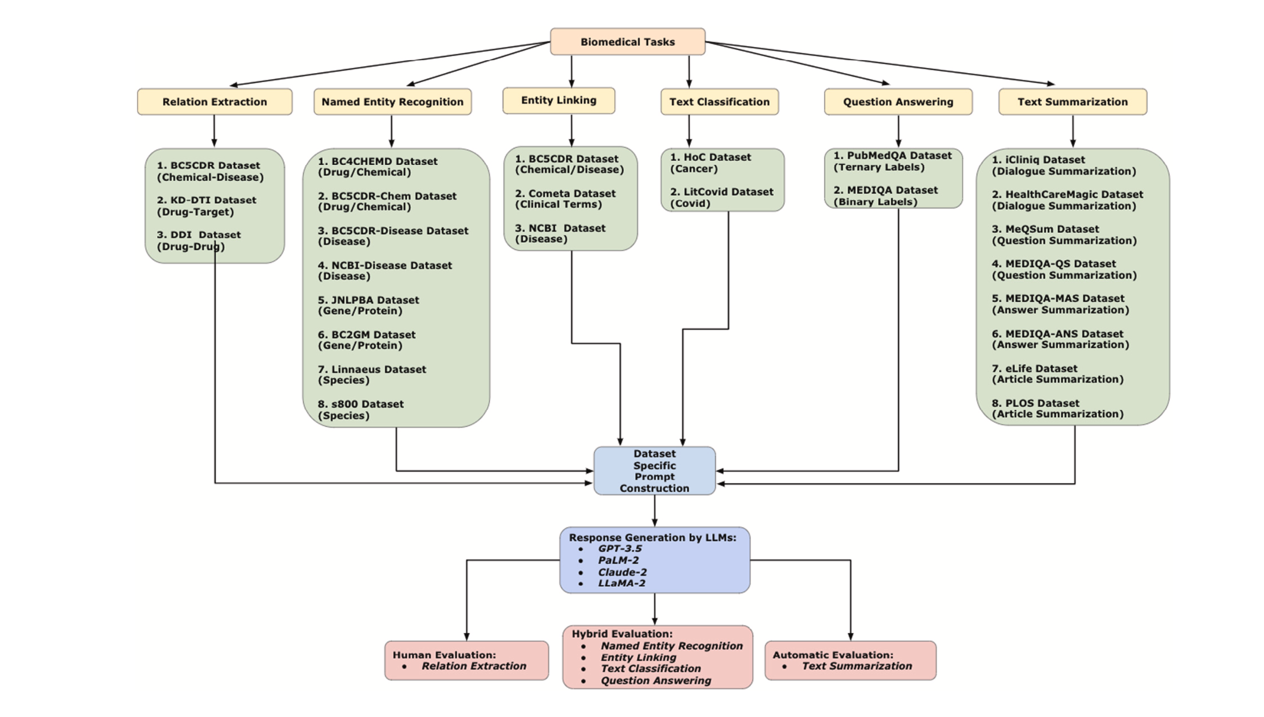
How to evaluate 6
biomedical tasks?
9

Slide 10
II. Biomedical task description
2.1 Biomedical named entity recognition (NER)
Task of identifying named entities like person, location, organization, drug, disease, etc. in a given text.
Aims to extract the biomedical named entities
Genes, proteins, diseases, chemicals ……
10

Slide 11
II. Biomedical task description
2.1 Biomedical named entity recognition (NER)
Example:
The patient has been diagnosed with a rare form of cancer and is undergoing chemotherapy treatment with the drug Taxol.
Expected NER classifications:
• NER (Disease): ‘‘rare form of cancer’’.
• NER (Treatment): ‘‘chemotherapy’’. • NER (Drug): ‘‘Taxol’’.
11

Slide 12
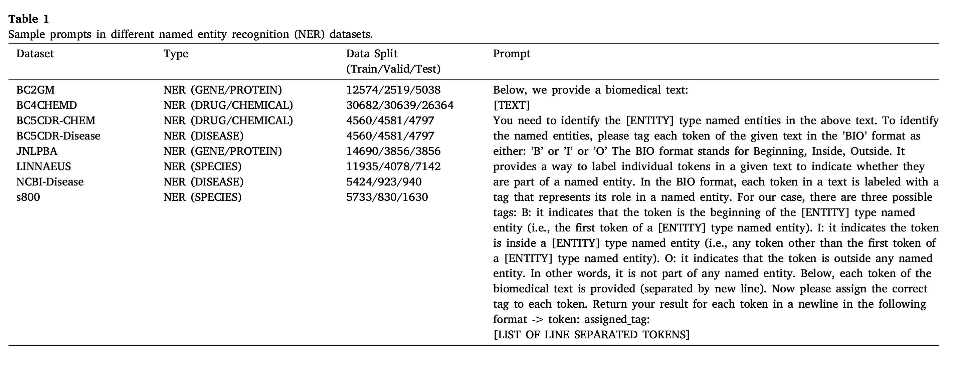
2.1 NER 命名实体识别
如何通过精心设计的提示信息来引导LLM在BM任务中进行有效处理和分析？
12

Slide 13
II. Biomedical task description
2.2 Biomedical relation extraction 生物医学关系提取
Aims to extract relations between named entities in a given text
通过识别哪些基因对哪些疾病负责，哪些治疗/药物对哪些疾病有效，以及识别药物相互作用等来分析文本数据。
13

Slide 14
II. Biomedical task description
2.2 Biomedical relation extraction 生物医学关系提取
Example: The patient has been diagnosed with a rare form of cancer and is undergoing chemotherapy treatment with the drug Taxol.
Expected Relation Extractions:
Relation (Treatment of a Disease): ‘‘chemotherapy’’ is a treatment for ‘‘rare form of cancer’’.
Relation (Drug used in Treatment): ‘‘Taxol’’ is a drug used in ‘‘chemotherapy’’.
14

Slide 15
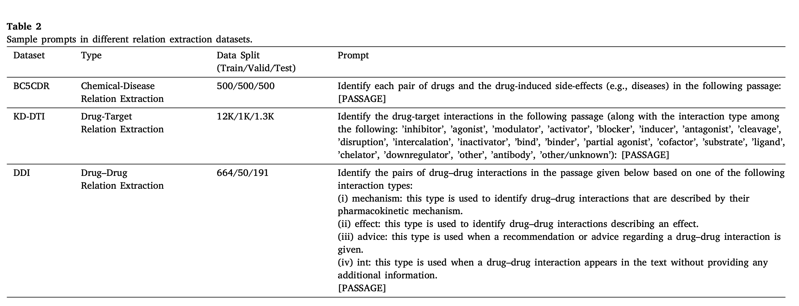
2 Relation Extraction 关系抽取
15

Slide 16
II. Biomedical task description
2.3 Biomedical entity linking 生物医学实体链接
The entity linking task focuses on linking named entities in a text to their corresponding entries in a knowledge base.
Example: The patient has been diagnosed with a rare form of cancer and is undergoing chemotherapy treatment with the drug Taxol.
Expected Entity Linking: A biomedical entity linking system may link the drug Taxol to the following link: https://chemocare.com/drugin fo/taxol.
16

Slide 17
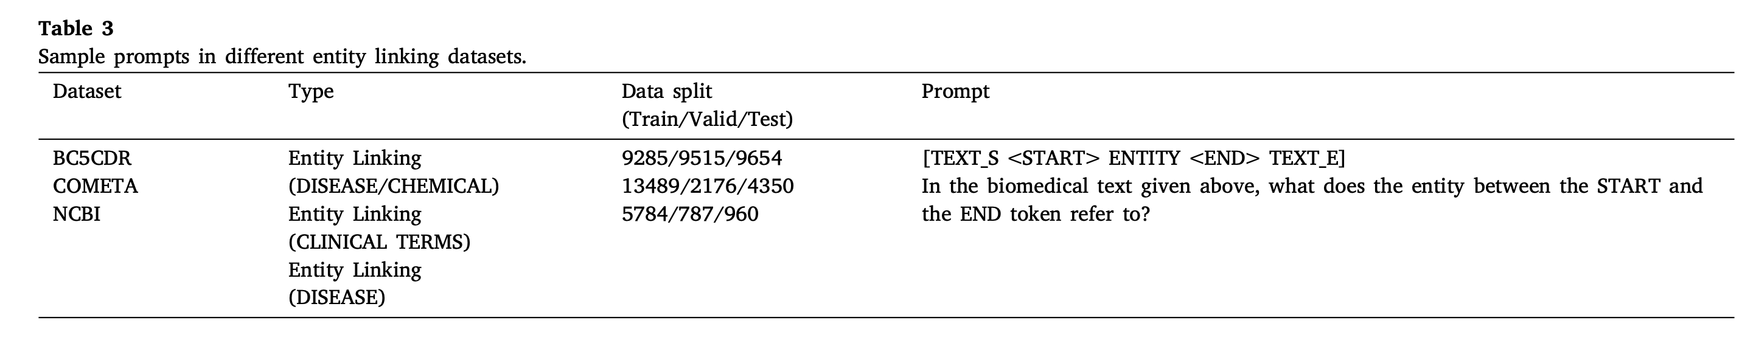
3 Entity linking 实体链接
17

Slide 18
II. Biomedical task description
2.4 Biomedical text classification
For a given text, the goal of this task is to classify the text into a specific category.
Example: ‘‘Heterogeneity in DNA damage within the cell population was observed as a function of radiation dose.’’
Expected Result: Genomic Instability and Mutation.
18

Slide 19
II. Biomedical task description
2.5 Biomedical question answering
The biomedical question-answering task involves retrieving the relevant answer for the given question related to the biomedical literature.
scientific articles
medical records
clinical trials
This task is of great importance as it can help healthcare professionals, researchers, and patients access relevant information quickly and efficiently.
19

Slide 20
II. Biomedical task description
2.5 Biomedical question answering
Example: What is recommended for thalassemia patients ?
• Candidate Answer 1: Chemotherapy may be used to: Cure the cancer, shrink the cancer, and prevent the cancer from spreading.
• Candidate Answer 2: Regular blood transfusions can help provide the body with normal red blood cells containing normal hemoglobin.
Expected Answer: The candidate answer 2 should be retrieved as a relevant answer
20

Slide 21
II. Biomedical task description
2.6 Biomedical text summarization
generate a short concise summary of the given document
Example: Patient is a 62-year-old female with a medical history of hyperlipidemia, osteoarthritis, and previous cerebrovascular accident. She presented with sudden onset of dizziness and palpitations that began a day ago. An electrocardiogram was immediately conducted, which indicated the presence of atrial fibrillation. She was promptly hospitalized for monitoring and commenced on anticoagulation therapy with warfarin and rate-controlling medications like beta-blockers.
Expected Summary: A 62-year-old female with a history of hyper- lipidemia, osteoarthritis, and a previous cerebrovascular accident experienced sudden dizziness and palpitations. An ECG confirmed atrial fibrillation, leading to her hospitalization and treatment with warfarin and beta-blockers.
21

Slide 22
03
Methodology: 4 models
In the following, we describe the 4 popular LLMs that we evaluate in benchmark biomedical datasets and tasks.
22

Slide 23
IV methodology: 4 models
(1) GPT 3.5
1) GPT-3.5 是一种基于 Transformer 架构的自回归语言模型。它主要使用了 Transformer 的解码器部分来生成文本。
2)训练方法：GPT-3.5 经过了大量文本数据的预训练，通过RLHF进一步优化。
RLHF 包括两个阶段：首先是监督学习阶段，模型通过大量对话数据进行训练；然后是通过人类反馈进行强化学习，模型根据人类对生成内容的反馈进行进一步的优化。
23

Slide 24
IV methodology: 4 models
(2) PaLM-2
基于 Transformer 架构的语言模型,在模型规模和训练数据集规模之间实现了更好的比例，使其在保持高性能的同时，具有更高的计算效率。
(3) Claude-2
基于 Transformer 架构的语言模型，专注于提高输出内容的无害性和安全性，减少生成有害或危险内容的可能性。
24

Slide 25
IV methodology: 4 models
(4) LLaMA-2
LLaMA-2 是由 Meta 提出的 LLM，也是这四种模型中唯一一个开源的模型。 基于 Transformer 架构，并提供了多种模型规模
训练方法：LLaMA-2 通过无监督预训练、监督微调和RLHF进行训练。相比于 LLaMA-1，LLaMA-2 不仅允许商业使用，还在各种任务中表现出色。
25

Slide 26
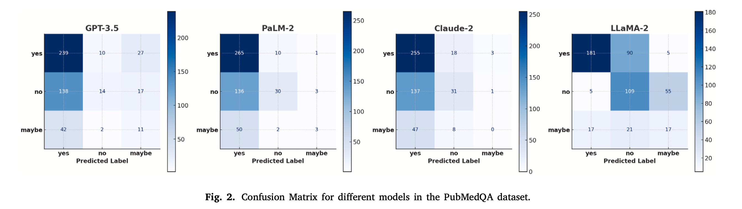
IV methodology: 4 models
PubMedQA：Confusion matrix
26

Slide 27
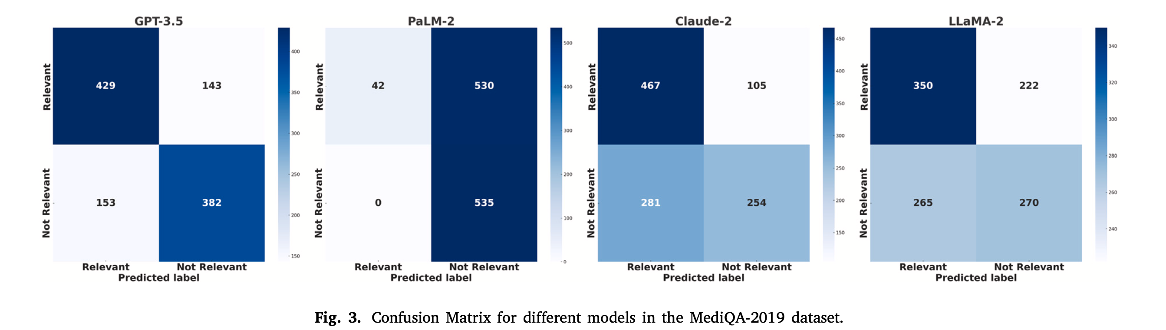
IV methodology: 4 models
MediQA-2019
27

Slide 28
summary
01 the key findings of study and suggest potential directions for future research.
02 highlight the performance differences of the four large language models
03 Future work includes optimizing model performance in specific domains and exploring more complex biomedical tasks.
28

Slide 29
Thanks!
Please keep this slide for attribution

